Slide 1


CHOW SIEW KEAN
21 Nov 2024

Slide 2
Outline
Executive Summary
Introduction
Methodology
Results
Conclusion
Appendix

Slide 3

Executive Summary
Summary of methodologies:-
SpaceX advertises Falcon 9 rocket launches with a cost of 62 million dollars; SpaceX Falcon 1 was launched between 2005-2009, while SpaceX Falcon 9 was launch since 2010 with reusable launch vehicle.
Analysist with Juypyer Lab with Web API to create an insight reports SpaceX Falcon 9 performance.
Create dashboard in real time of the SpaceX Launch Site performance.

Slide 4
Executive Summary
Summary of results:-
Study few factors on SpaceX Falcon9, a reusable heavier lift vehicle.
Compare result & prediction insight to justify the investment risk with success rate & accuracy of the data.
Compare result & prediction insight to justify the estimation cost investment by review the Payload Mass usage.
Present to shareholder for decision make refer to the performance report that is high potential for next investment on next bidding.

Slide 5
Introduction
Project SpaceX Falcon 9 first stage Landing Research. Source data from wikipedia with webpage title : List of Falcon 9 & Falcon Heavy Launches.
Shareholders seek insight information to justify, if the company shall proceed bit again SpaceX for rocket launch refer records between year 2010-2020.
Main consideration on first stage of landing, cost of a launch, the success rate of the SpaceX Falcon 9.
To determine the investment cost estimation on bidding project.

Slide 6

Section 1

Slide 7
Methodology
Executive Summary
Data collection methodology:
Data was collected from Space API to parse the SpaceX launch data with GET request.
Perform data wrangling
Data was processed with BeautifulSoup to wep scrap Falcon 9 launch records.
Perform exploratory data analysis (EDA) using visualization and SQL
Perform interactive visual analytics using Folium and Plotly Dash
Perform predictive analysis using classification models
Conduct Machine Learning to build, tune, evaluate classification models. Identified best hyperparameters for SVM, Classification Trees and Logistic Regression

Slide 8
Data Collection
Identify data source from Wikipedia. With Jupyter labs, make a GET request to the SpaceX API
Data collection process use key phrases and flowcharts
Import Relevant Libraries into Jupyter Lab
Use helper function on API to extract information from web as SpaceX Launch Data
Request & parse the SpaceX launch data
Overview the data in dataframe.
Filter the data for Falcon 9 launches only.

Slide 9
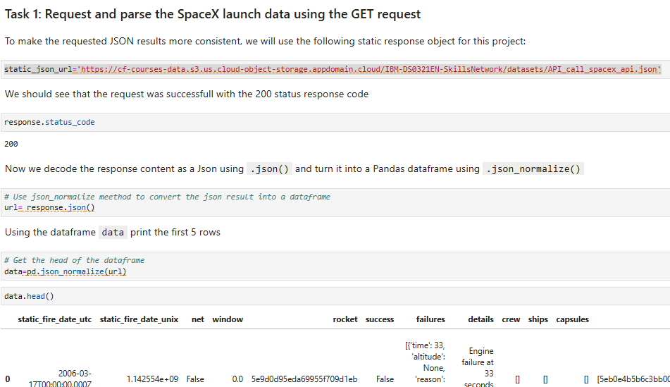
Data Collection – SpaceX API
Detail refer GitHub URL as link below :-<testpo1/DS M1 spacex-data-collection-api.ipynb at main · skchowinnie/testpo1>
Use Json_normalize method to convert Json result. Convert data into dataframe for overview.
Use API helper function to get information as rocket, payloads, launchpad, and cores.
Apply GetBoosterVerson & other functions. Combine relevant data into a dictionary & create new dataframe
Request & parse data by using GET request.

Slide 10
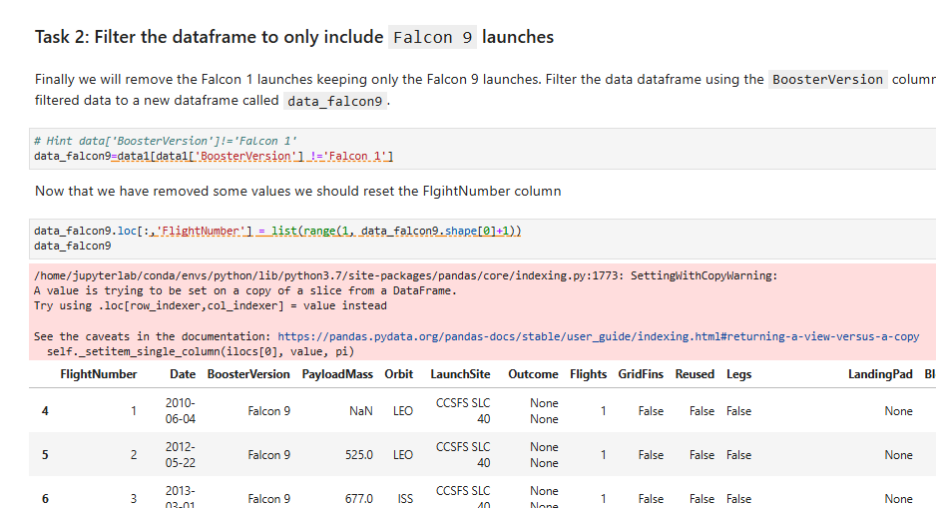
Data Collection – Scraping Filter Dataframe
Place your flowchart of web scraping here
Remove data of Falcon 1
Reset data via FlightNumber column

Slide 11
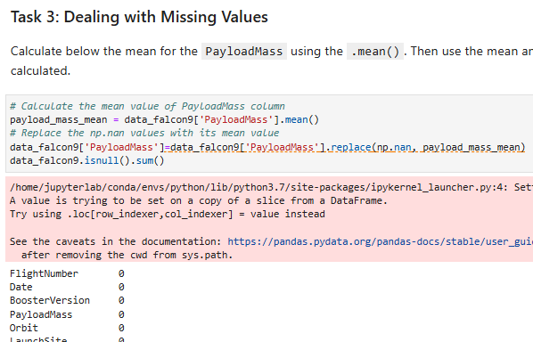
Data Wrangling
Place your flowchart of web scraping here
Idenfity any missing values in dataset.
Replace those missing values by replace function with mean values.

Slide 12
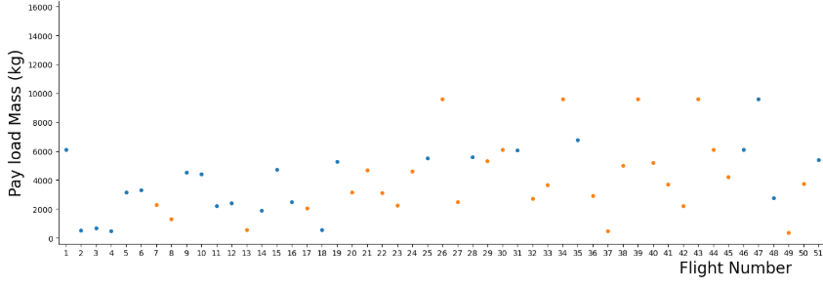
EDA with Data Visualization
Perform exploratory Data Analysis and Feature Engineering using Pandas and Matplotlib
Visualize the relationship between Flight Number and Launch Site
Visualize the relationship between Payload Mass and Launch Site.
Visualize the relationship between success rate of each orbit type
Visualize the relationship between FlightNumber and Orbit type
Visualize the relationship between Payload Mass and Orbit type
Visualize the launch success yearly trend
Create dummy variables to categorical columns

Slide 13
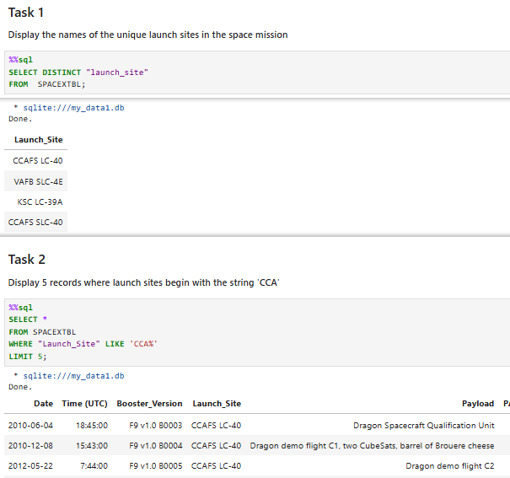
EDA For SQL
Overview dataset to determine the cost of a launch with SQL Notebook.
Place your flowchart of web scraping here
Identify & list 5 unique launch sites.
Display Total & Average of PayloadMass by Boosters launched by NASA.
Identify & List those successful & failure records on landing outcome via Boosters Versions
Rank the landing outcomes between Year 2010-2017.
Detail refer github<testpo1/DS M2Complete the EDA with SQL.ipynb at main · skchowinnie/testpo1>

Slide 14
Build an Interactive Map with Folium
Actions on Visual Analytics with Folium
1: Mark all launch sites on a map
2: Mark the success/failed launches for each site on the map
3: Calculate the distances between a launch site to its proximities
With finding of existing launch site with each success rate to predict the optimal location for future launching.
Detail refer GitHub URL as link below :-<testpo1/DS M3 Interactive Visual Analytics with Folium.ipynb at main · skchowinnie/testpo1>

Slide 15
Build a Dashboard with Plotly Dash
To monitor interactive visual analytics on SpaceX launch data in real time at dashboard.
SpaceX Launch Records Dashboard with 2 Type of Charts
1. Pie Chart to show the success rate of each launch
2. Scatter Plot show the launch site with PayLoadMass

Slide 16
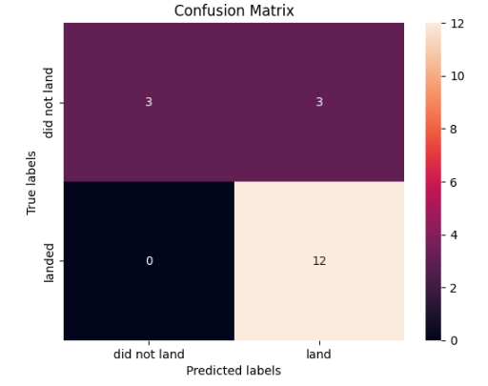
Predictive Analysis (Classification)
Identify data & split train & test samples set.
Create a logistic regression object with GridSearchCV. Calculate accuracy & confusion matrix.
Create a support vector machine, SVM with GridSearchCV. Calculate accuracy & confusion matrix.
Create a DecisionTree classifier object with GridSearchCV. Calculate accuracy & confusion matrix.
Create a K nearest neighbors object with GridSearchCV. Calculate accuracy & confusion matrix.
Summarize results with machine learning tool. To evaluate, improve and found the best performing classification model.

Slide 17
Results
Exploratory data analysis results refer section 2
Interactive analytics detail refer section 4
Predictive analysis results refer section 5

Slide 18

Section 2

Slide 19
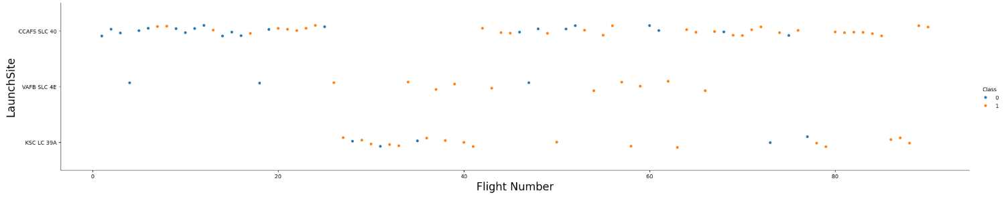
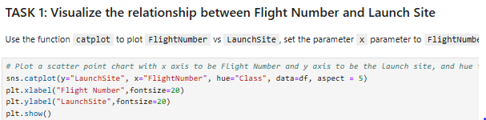
Flight Number vs. Launch Site
Refer to scatter plot there is not relationship within Flight Number via LaunchSite

Slide 20
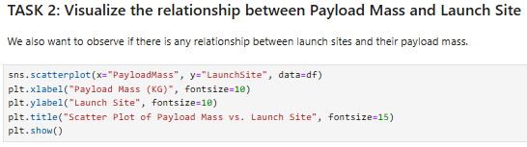
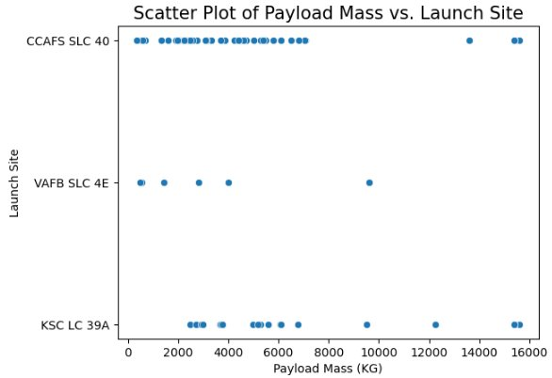
Payload vs. Launch Site
Refer to scatter plot there is no relationship between PayloadMass Via Launch Site.

Slide 21
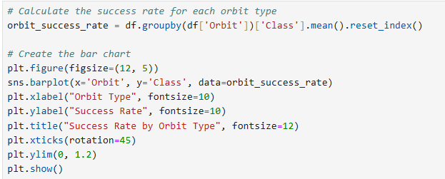
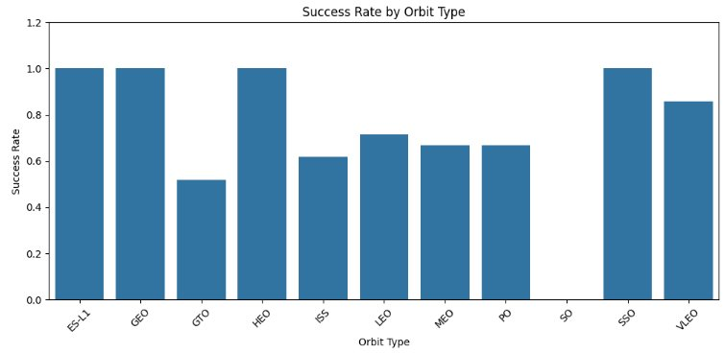
Success Rate vs. Orbit Type
The bar chart show highest success rate on Orbit of ES-L1, GEO, HEO & SSO. Zero record on SO Orbit.

Slide 22
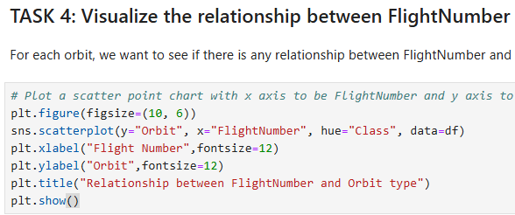
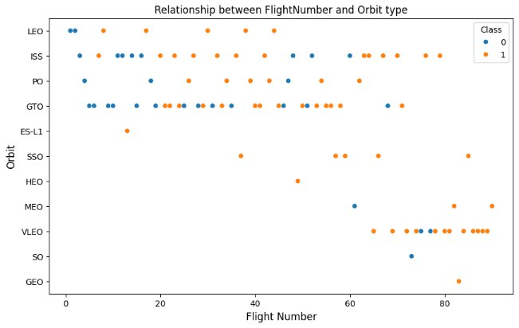
Flight Number vs. Orbit Type
Orbit SSO & HEO never have failure record. While SSO have 5 Flights compare to HEO 1 Flight.

Slide 23
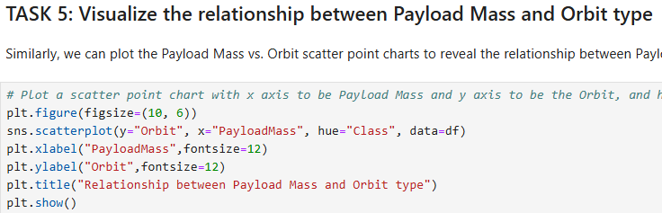
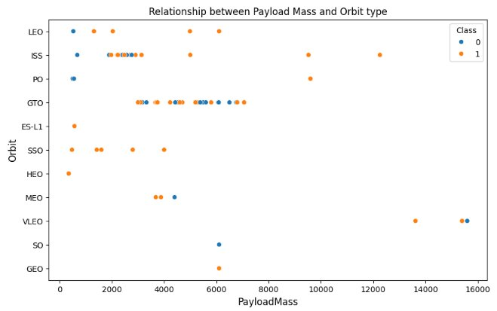
Payload vs. Orbit Type
Orbit SSO & HEO having success record with lowest Payload Mass.

Slide 24
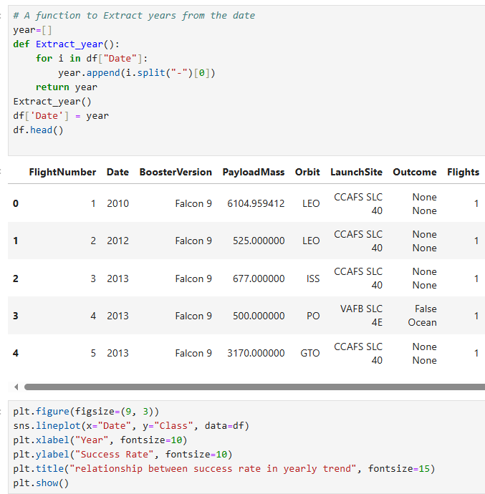
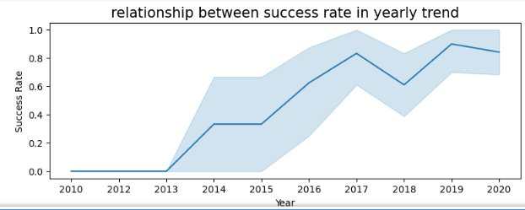
Launch Success Yearly Trend
There is dramatic increase of success rate since Year 2013 until Year2020.

Slide 25
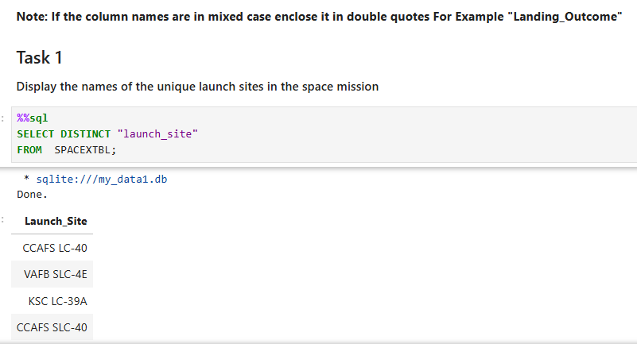
All Launch Site Names
There is 4 Launch Site from Landing Outcome.

Slide 26
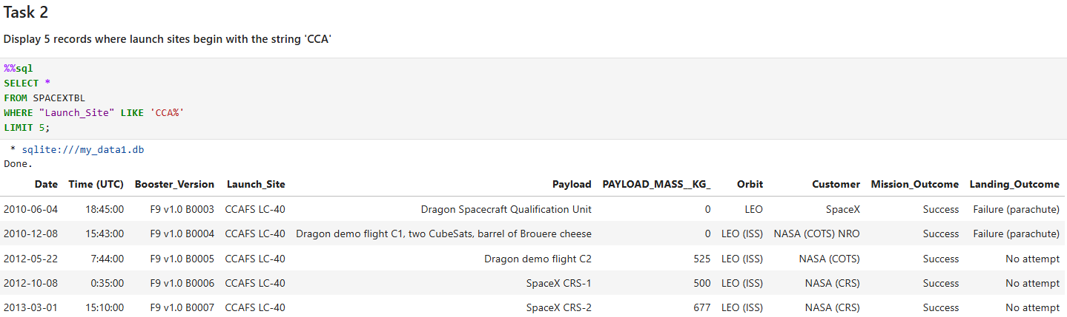
Launch Site Names Begin with 'CCA'
CCA Launch Site start since Y2010.

Slide 27
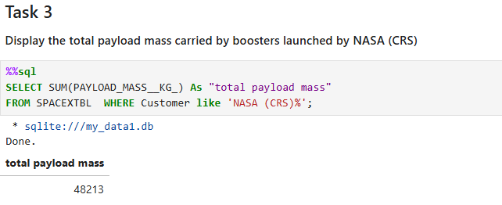
Total Payload Mass
Refer calculation total payload mass is 48213Kg

Slide 28
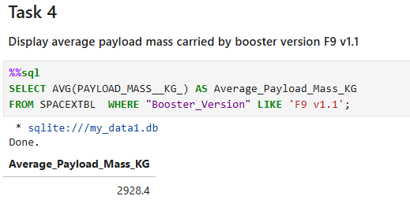
Average Payload Mass by F9 v1.1
Refer calculation average payload mass by F9 v1.1 is 2928.4Kg

Slide 29
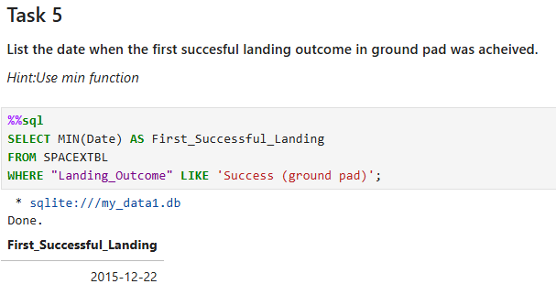
First Successful Ground Landing Date
First successful ground landing data on 22 Dec 2015.

Slide 30
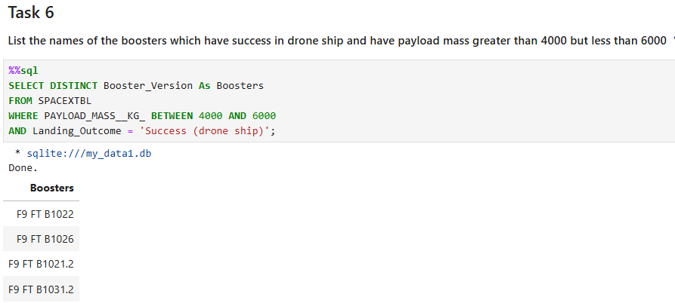
Successful Drone Ship Landing with Payload between 4000 and 6000
There is 4 successful drone ship landing payload as Boosters.

Slide 31
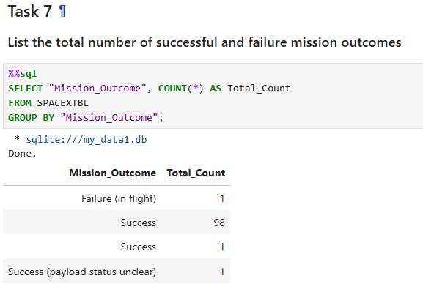
Total Number of Successful and Failure Mission Outcomes
There is 4 type of Mission Outcome with total successful mission is 101.

Slide 32
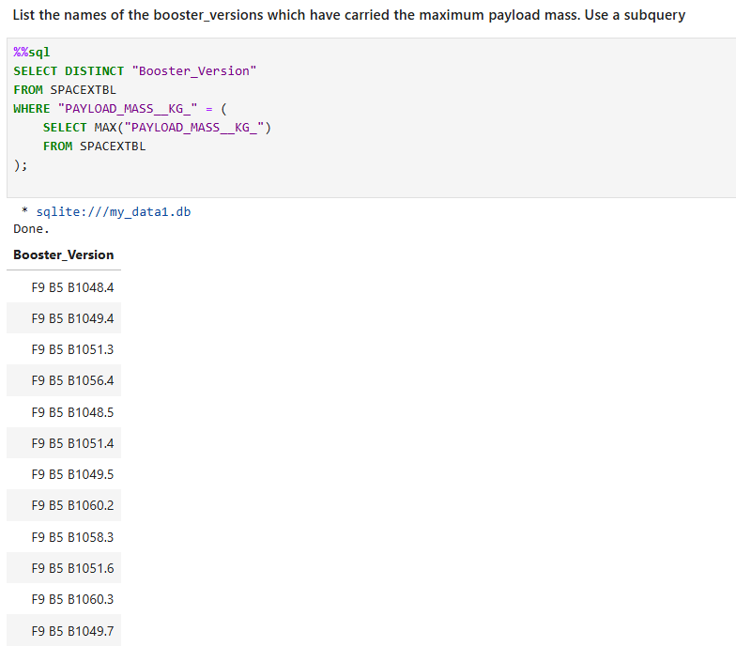
Boosters Carried Maximum Payload
There is 12 Booster Version found as maximum payload mass.

Slide 33
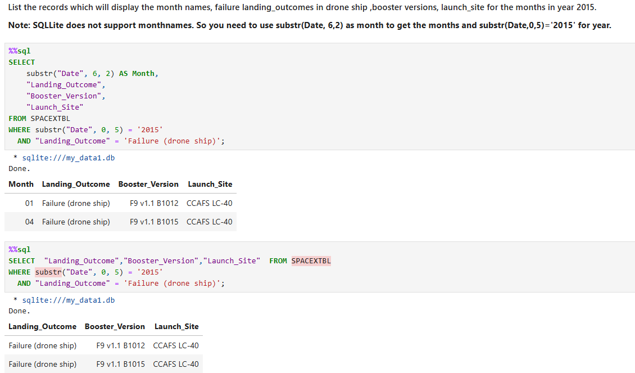
2015 Launch Records
There is 2 failure drone ship found at Jan & April 2015.

Slide 34
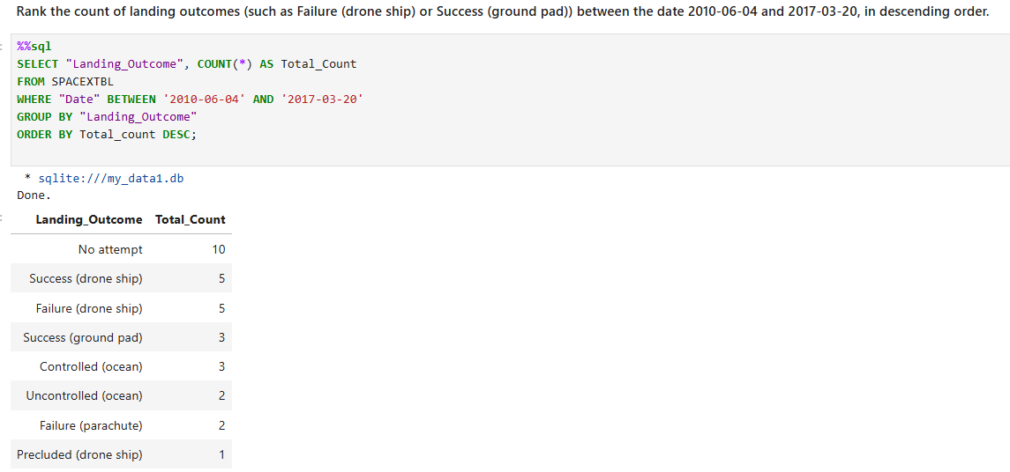
Rank Landing Outcomes Between 2010-06-04 to 2017-03-20
There is 8 type of Landing Outcomes. While the highest count is 10 that record at No attempt.

Slide 35

Section 3

Slide 36
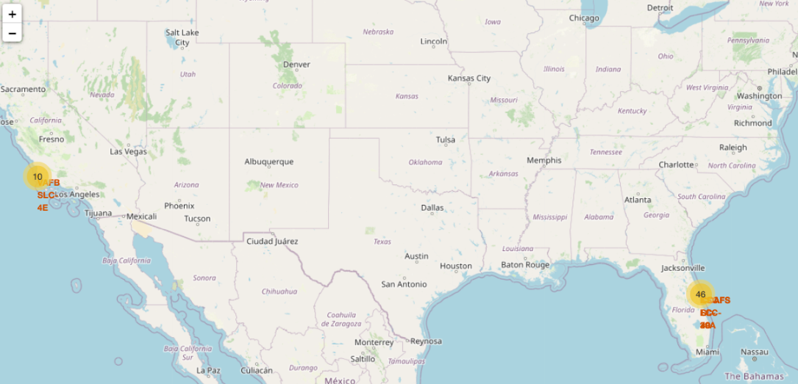
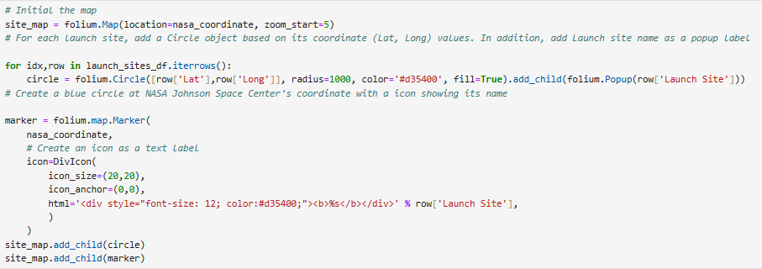
<Folium Map Screenshot 1>
Site map of Space launch site.

Slide 37
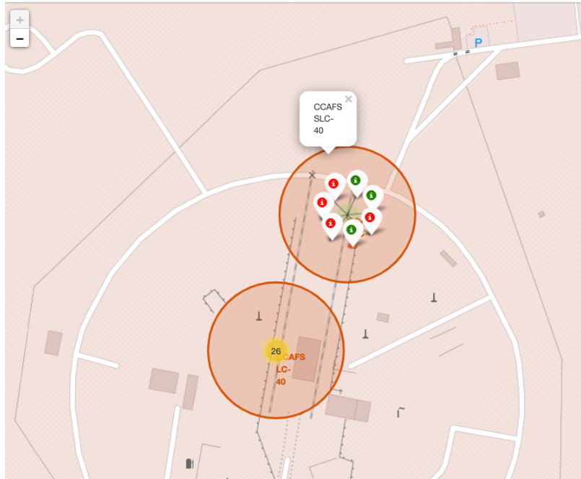
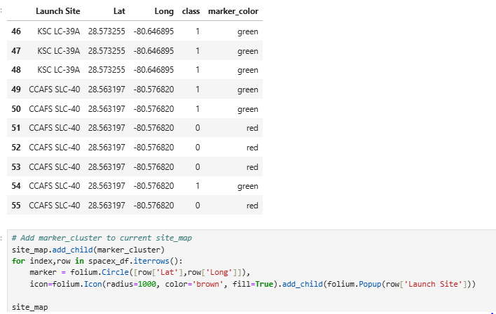
<Folium Map Screenshot 2>
Marker cluster to site map

Slide 38
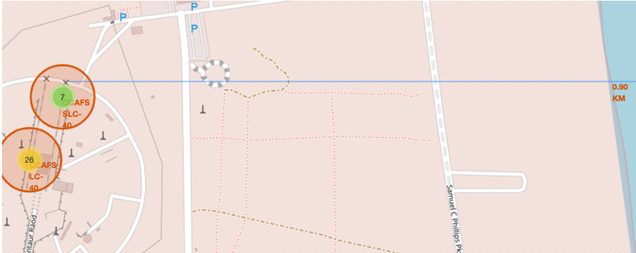
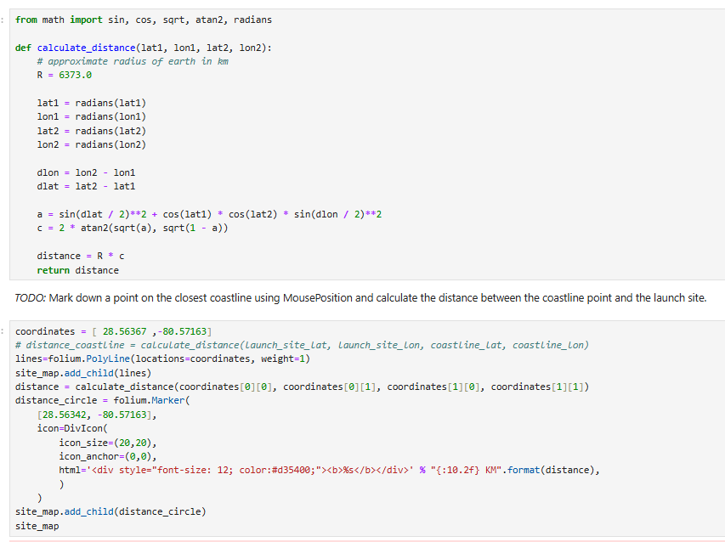
<Folium Map Screenshot 3>
Site map show distance between the coastline point and the launch site

Slide 39

Section 4

Slide 40
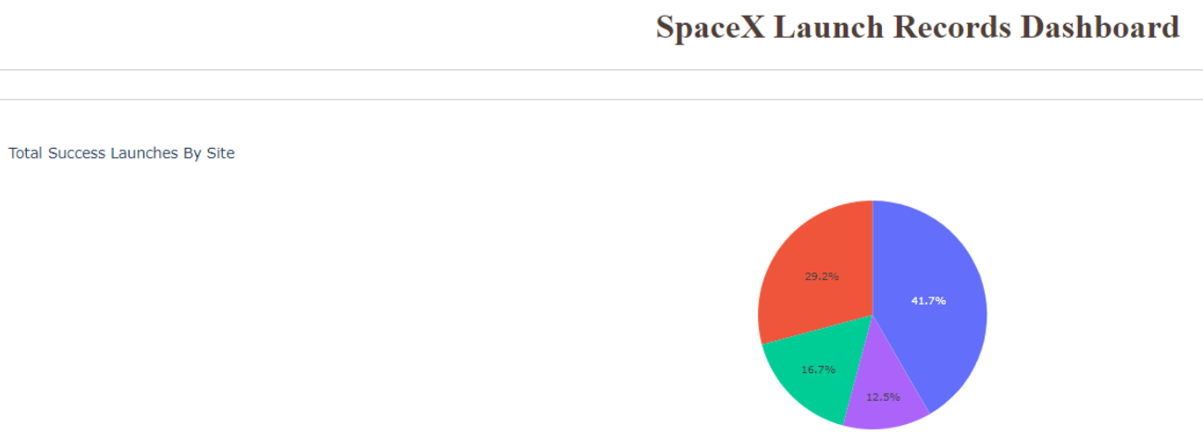
SpaceX Launch by Site Dashboard
The piechart show Launch site CCAFS SLC 40, VAFB SLC 4E, CCAFS LC-40 & VAFB SLC-4E.
CCAFS LC-40 with the highest success rate at 41.7%

Slide 41
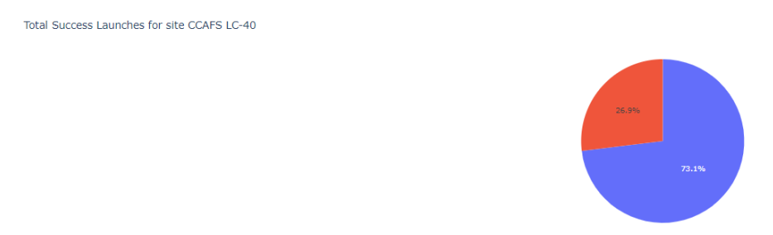
Total Success Launch for site CCAFS LC-40 Dashboard
The piechart show Total Success Launch site CCAFS SLC 40 at 73.1%
CCAFS LC-40 is having highest confident level as Launch Site to be the best option to be selected.

Slide 42
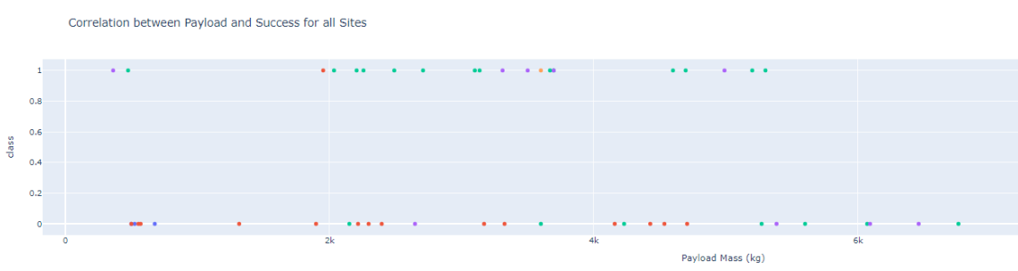
Payload vs. Launch Outcome scatter plot
The Scatterplot show correlation of Payload Mass Via Success of launch sites.

Slide 43

Section 5

Slide 44
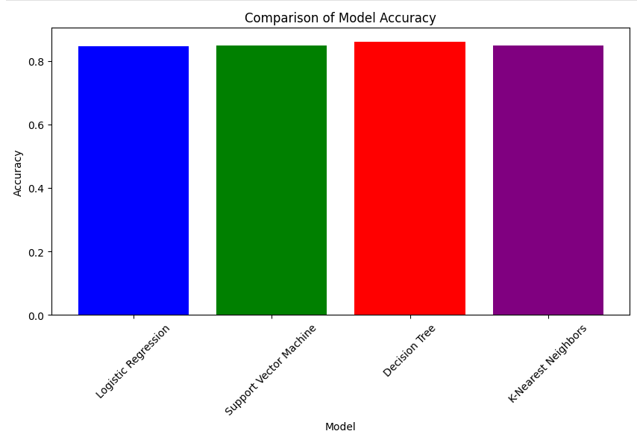
Classification Accuracy
The bar chart show tuned hpyerparameter Accuracy Via build models.
All models show tuned hpyerparameter accuracy above 80%.
DecisionTree is the highest at 86.07% accuracy

Slide 45
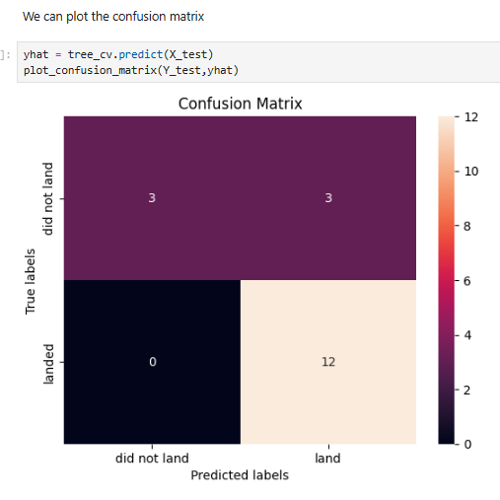
Confusion Matrix
The confusion matrix show the build model of Logistic Regression', 'Support Vector Machine', 'Decision Tree', 'K-Nearest Neighbor.
All models show same result with method score accuracy 83.33%

Slide 46
Conclusions
The SpaceX Falcon9 records show high potential for bidding.
There is dramatic increase of success rate since Year 2013 until Year2020.
First successful ground landing data on 22 Dec 2015, over 9 years developments experiences.
The best Orbit type is SSO.
CCAFS LC-40 is the highest success rate of launch site.
The major costing estimation can refer to the usage of PayloadMass.

Slide 47
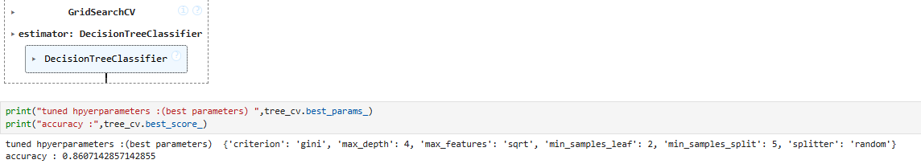
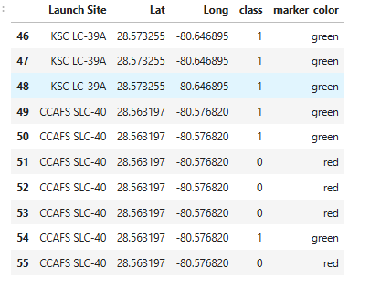
Appendix
Machine Learning with Decision Tree Classifier found the the highest accuracy of tuned hpyerparameter at 0.8607. While the accuracy with method score is 0.8333
At Folium, we can change the numeric into object from data frame by apply assign_marker_color. This enhance better visibility on to classify success in green, failure in red.

Slide 48


